Slide 1



Instituto Politécnico Nacional Escuela Superior de Cómputo
Evolutionary Computing
Anarchy Society Optimization
“ASO”
Students:
Naranjo Ferrara Guillermo
Quiroz Palacios Pedro Manuel
Vizcaino Lopez Fernando
Teacher : Jorge Luis Rosas Trigueros
29/05/2020

Slide 2

INTRODUCTION
What is Anarchy?
Anarchic is derived from the Greek word anarkos meaning “no boss” and Anarchia means “lack of government”.
According to the view of Anarchists, a society can be managed without the need of the central government and only based on individuals or volunteer groups.
In this case, individuals or groups will be able to determine the right direction without being ordered by a ruling power and only based on their others’ previous experiences.

Slide 3
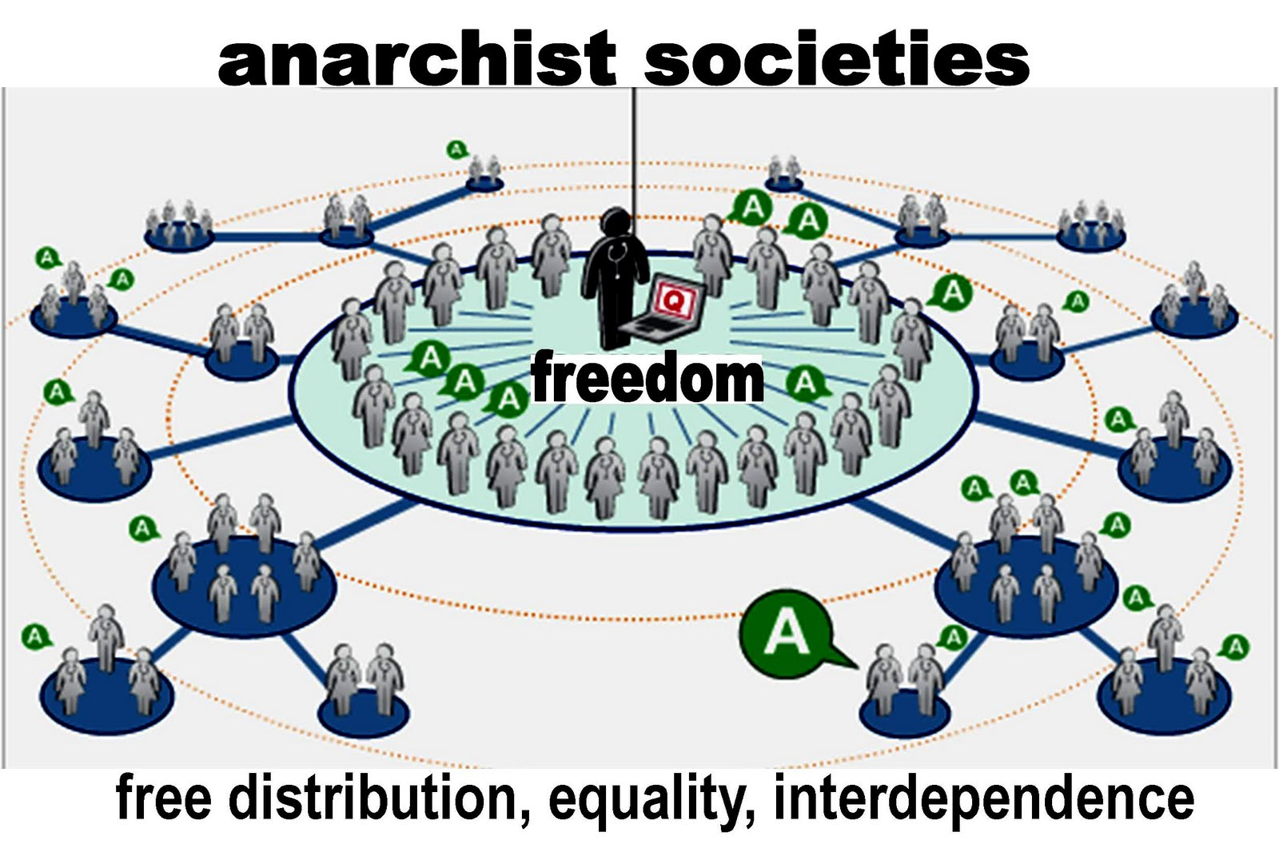
Anarchy, defined as a system in which participants can seize and defend resources without regulation from above, is not chaos but rather a spontaneous order.
Under anarchy, each contestant balances between productive exploitation of the current resource base and fighting to acquire or defend resources.

Slide 4


Socio-Inspired Algorithms
Socio-inspired algorithms are one such very recent and upcoming class of optimization algorithms, which use the idea of simulating and mimicking social learning of humans (or social evolution).
Humans adapt to mannerisms and behaviours by observing/imitating other individuals which helps them improve their intelligence quickly and achieve shared goals.
The tendency to cooperate and function together as a cohesive group adds to their collective intelligence.

Slide 5
Some behaviors of the Socio-Inspired Algorithms
Cooperative interaction in order to improve their overall behavior.
Competition between the individuals in the pursuit to be the strongest or their self-goals.
Learning from others based on their behavior, or on the response of the self-behavior
Cooperation
Giving support to the fittest individual.
Following of ideologies or beliefs to achieve their goals.

Slide 6

Anarchic Society Optimization (ASO)
ASO is an innovative optimization method inspired by a human society whose members behave anarchically to improve their situations.
In ASO the members are fickle, and their unpredictability increases as their situation worsens.
They also behave irrationally and adventurously, moving toward the inferior positions they have visited.

Slide 7
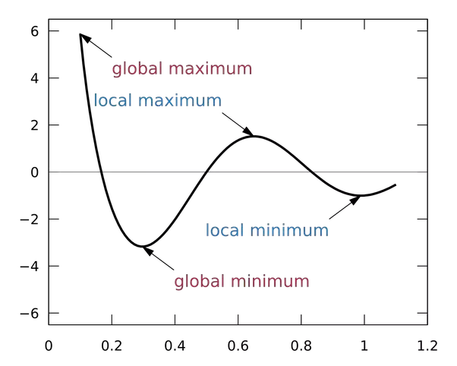
Using these anarchic members, ASO is able to search the solution space perfectly and avoid falling into local optimum traps.

Slide 8
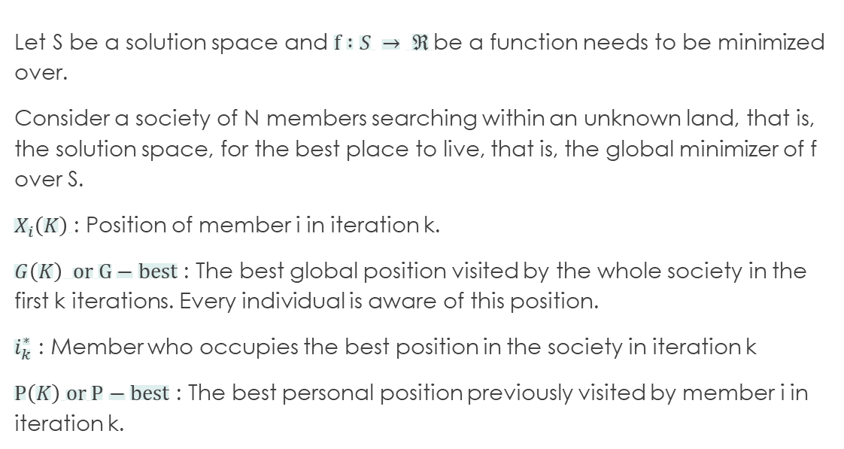
Basic Assumptions and Notation
Let S be a solution space and $f :S → ℜ$be a function needs to be minimized over.
Consider a society of N members searching within an unknown land, that is, the solution space, for the best place to live, that is, the global minimizer of f over S.
$X_{i}\left(K\right)$: Position of member i in iteration k.
$G\left(K\right) or G−best$ : The best global position visited by the whole society in the first k iterations. Every individual is aware of this position.
$i_{k}^{∗}$ : Member who occupies the best position in the society in iteration k
$P\left(K\right) or P−best$ : The best personal position previously visited by member i in iteration k.

Slide 9


Movement Policies
Each member has a planning procedure to decide how it will move and change his/her possition in the next iteration
Selection of movement policy based on the current position
It’s denoted by $MP_{i}^{Current}(k)$
Each member chose its own neighbouring method
We consider the flickness function ${FI(k)}_{i}$

Slide 10
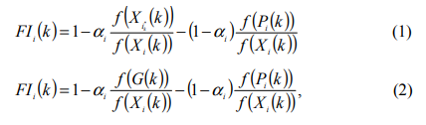

When the objective function $f$ is positive on $S$, ${FI(k)}_{i}$ may be defined as one of the following, for some nonnegative number $∝_{i}$in $[0,1]$

Slide 11
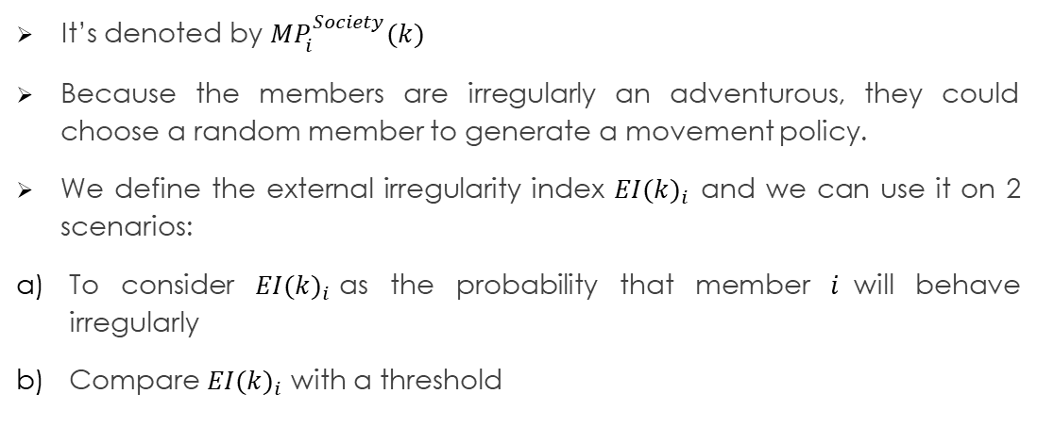
2) Selection of movement policy based on other members’ positions
It’s denoted by $MP_{i}^{Society}(k)$
Because the members are irregularly an adventurous, they could choose a random member to generate a movement policy.
We define the external irregularity index ${EI(k)}_{i}$ and we can use it on 2 scenarios:
To consider ${EI(k)}_{i}$as the probability that member $i$will behave irregularly
Compare ${EI(k)}_{i}$ with a threshold

Slide 12

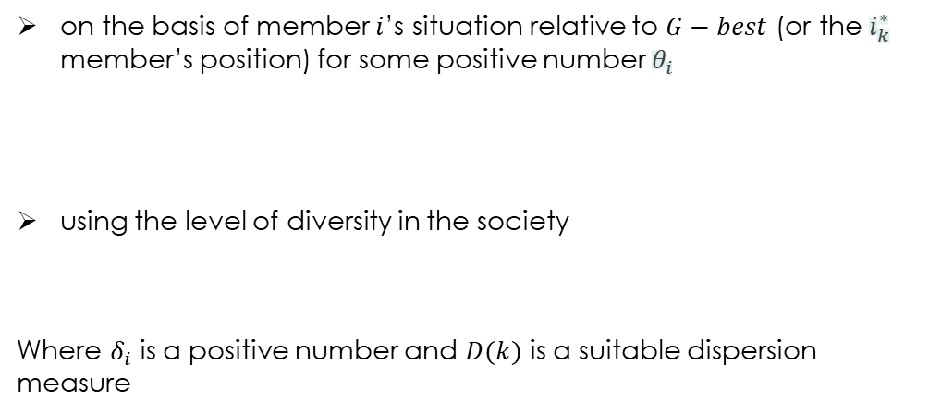


The number ${EI(k)}_{i}$ can be defined:
on the basis of member $i$’s situation relative to $G−best$ (or the $i_{k}^{∗}$ member’s position) for some positive number $θ_{i}$
using the level of diversity in the society
Where $δ_{i}$ is a positive number and $D(k)$ is a suitable dispersion measure
$${EI(k)}_{i}=1−e^{−θ_{i}[f\left(X_{i}\left(k\right)\right)−f(G(k))]}$$
$${EI(k)}_{i}=1−e^{−δ_{i}D(k)}$$

Slide 13
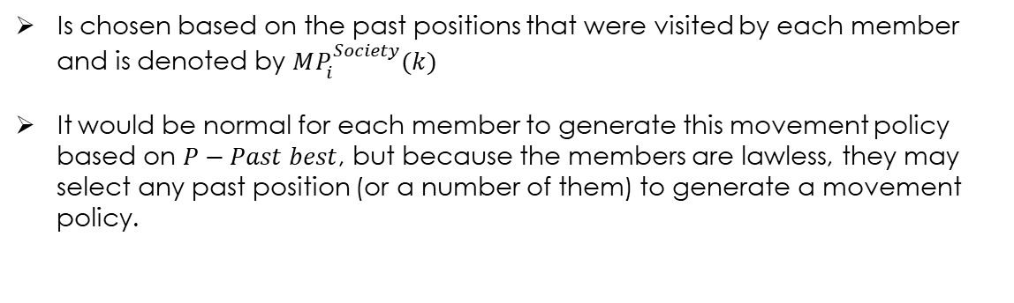
3) Selection of movement policy based on past positions
Is chosen based on the past positions that were visited by each member and is denoted by $MP_{i}^{Society}(k)$
It would be normal for each member to generate this movement policy based on $P−Past best$, but because the members are lawless, they may select any past position (or a number of them) to generate a movement policy.

Slide 14


The Internal Irregularity Index${ II(k)}_{i}$ for a member in iteration $k$is defined as follows
$${II(k)}_{i}=1−e^{−β_{i}[f\left(X_{i}\left(k\right)\right)−f(P_{i}(k))]}$$
For this movement we could chose different types of complex equation or only use a normal distribution.
This index can be used in the scenarios presented for the Externa Irregularity index, which are to use it like a probability, or use it as follows.

Slide 15
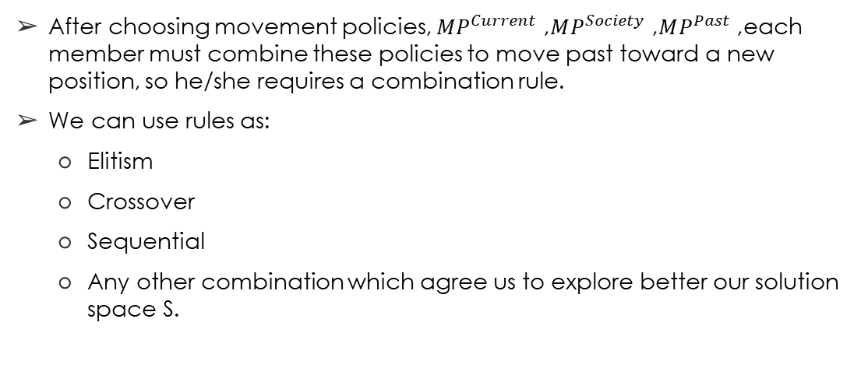
Combination rule
After choosing movement policies, $MP^{Current}$, $MP^{Society}$, $MP^{Past}$, each member must combine these policies to move past toward a new position, so he/she requires a combination rule.
We can use rules as:
Elitism
Crossover
Sequential
Any other combination which agree us to explore better our solution space S.

Slide 16
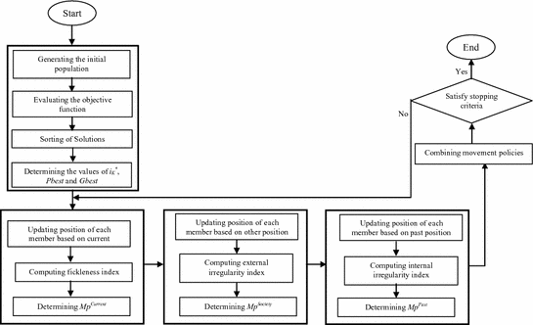
Algorithm

Slide 17
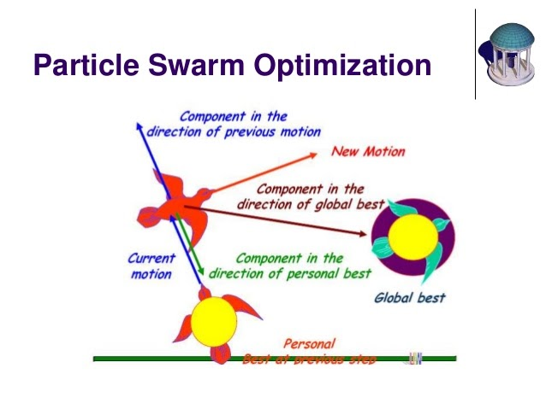
PSO as a special case of ASO

Slide 18
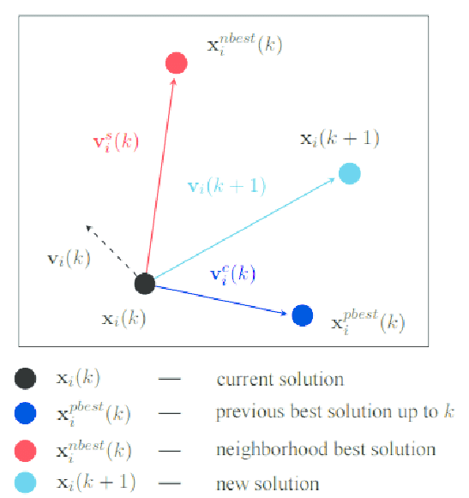
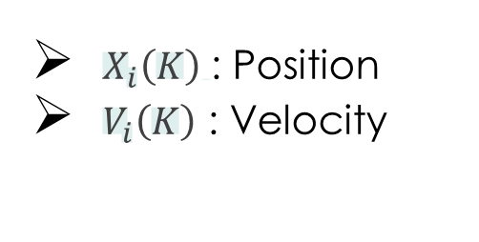
$X_{i}\left(K\right)$: Position
$V_{i}\left(K\right)$ : Velocity

Slide 19
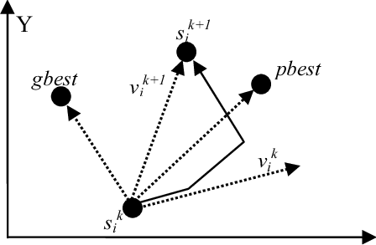
The d-dimensional vectors Pbest and Gbest are defined similarly as in ASO.

Slide 20

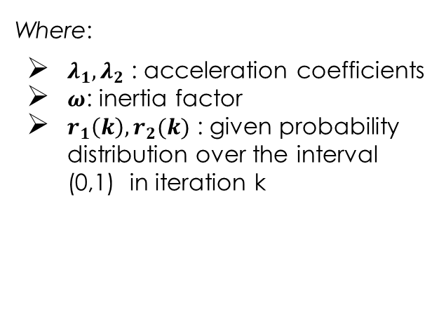
The new velocity of each particle is calculated as follows:
Where:
$λ_{1},λ_{2}$ : acceleration coefficients
$ω$: inertia factor
$r_{1}\left(k\right),r_{2}(k)$ : given probability distribution over the interval (0,1) in iteration k

Slide 21

Finally, the position of each particle is updated using the following equation:
The basic steps of the standard PSO are presented en 4 steps:
Step 1: Initialize a population of particles with random positions and velocities.
Step 2: Determine P-best and G-best in the current iteration.
Step 3: Update the velocity and position of each particle in the newest iteration according to Equations (5) and (6).
Step 4: If the stopping criterion is met, then stop; otherwise, go to Step 2.
$$X_{i}\left(k+1\right)=X_{i}\left(k\right)+V_{i}(k+1)$$

Slide 22
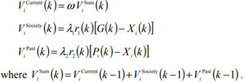
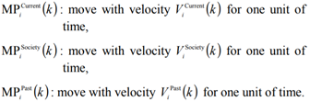
Let us define the following velocities:
Consider the following movement policies and combination rule.

Slide 23

The new position of member i after applying the above movement policies is similar to the case moves with velocity
Thus, we have

Slide 24
Advantages of Anarchic Society Optimization (ASO)
The algorithm is proposed in a very general way, which allows adaptability to various continuous and discrete problems.
Under certain conditions where theoretically, verified by a mathematical analysis converges to the global maximum

Slide 25
The Hybrid Flow-Shop Scheduling Problem
The problem is to find a schedule which optimizes a given objective function. The HFS problem is, in most cases, NP-Hard.
There’s an environment in which a set of n jobs are to be processed in a series of m stages. With the next considerations:
The number of processing stages m ≥ 2
Each stage k has M^{(k)}≥ 1 machines in parallel and in at least one of the stages M^{(k)} > 1
All jobs are processed following the same production flow: stage 1, stage 2,. . . , stage m.

Slide 26
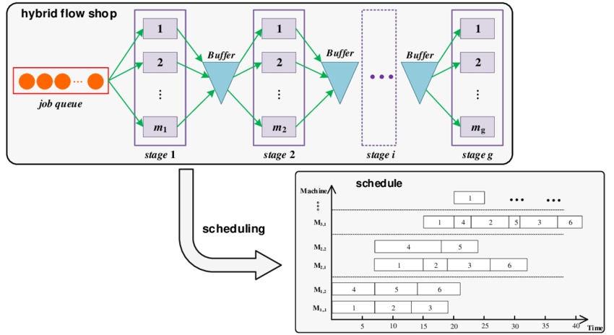

Slide 27
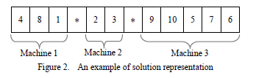
Application of the ASO to the Hybrid Flow-Shop Scheduling Problem
For this example, consider the next parameters:
n = 10
m = 2
M = 3 for the first stage
jobs 1, 4 and 8 with order 4→8→1 are assigned to machine 1
jobs 2 and 3 with order 2→3 are assigned to machine 2
jobs 9, 10, 5, 7 and 6 with order 9→10→5→7→6 are assigned to machine 3.
Chromosome

Slide 28
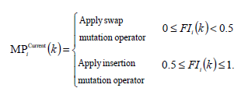
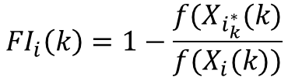

Movement Policy based on current position
$${FI}_{i}\left(k\right)=1−\frac{f(X_{i_{k}^{∗}}(k)}{f(X_{i}(k))}$$
Member
$$i≠i_{k}^{∗}$$

Slide 29

Randomly choose a machine t
Randomly choose two jobs for machine t
Swap chosen jobs
Member
$$i=i_{k}^{∗}$$
Randomly choose two machines t1 and t2
Randomly choose one job for machine t1 and one job for machine t2
Swap chosen jobs
Randomly choose one job j1 and one machine t, where job j1 does not belong to machine t
Choose randomly a valid position k in machine t
Transfer job j1 to machine t at position k

Slide 30
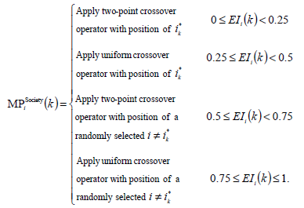


Movement Policy based on other members
Movement Policy based on Previous Positions
$${EI(k)}_{i}=1−e^{−CV (k)}$$
$${II(k)}_{i}=1−e^{−β_{i}[f\left(X_{i}\left(k\right)\right)−f(P_{i}(k))]}$$

Slide 31
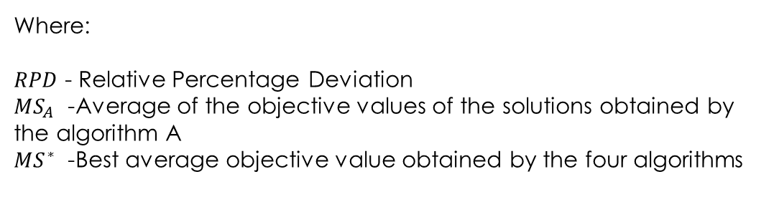

Results
All algorithms are coded in C++ and run with an Intel Pentium IV Core 2 Duo 2.5 GHz processor on 1024 MB RAM under a Windows operating system.
$$RPD=\frac{MS_{A}−MS^{∗}}{MS^{∗}}$$
Where:
$RPD$ - Relative Percentage Deviation
$MS_{A}$ - Average of the objective values of the solutions obtained by the algorithm A
$MS^{∗}$ - Best average objective value obtained by the four algorithms

Slide 32
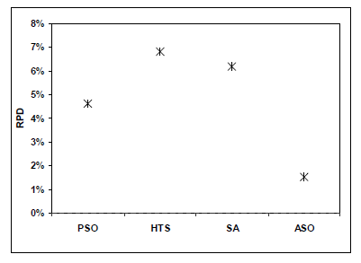
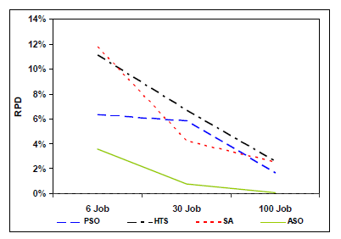

Slide 33
Some other applications

Slide 34

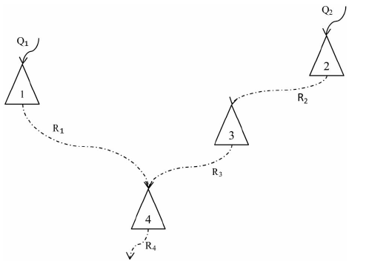
Optimization of operations of single and continuous multi-reservoir systems
ASO 93.88%
GA 91.86%
Global optimum 1.213
ASO 1.254
GA 1.535

Slide 35
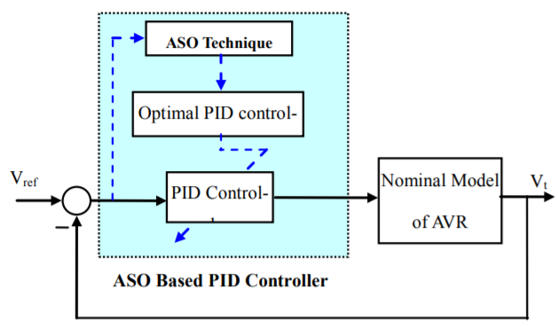

Anarchic Society Optimization Based PID Control of an Automatic Voltage Regulator (AVR) System

Slide 36
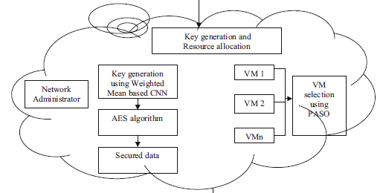
Performance improvement of Cloud Security

Slide 37
References
[1] A. Ahmadi, “Anarchic Society Optimization: A human-inspired method”, Proceedings of the IEEE Congress on Evolutionary Computation, New Orleans, LA, 2011, pp. 2586-2592.
[2] O. Bozorg-Haddad, Advanced Optimization By Nature-Inspired Algorithms, in Studies of Computational Intelligence, Vol. 720. 1st ed. Singapore: Springer, 2018.
[3] A. Bozorgi, O. Bozorg-Haddad, M. Rajabi, M. Latifi and X. Chu, “Applications of the anarchic society optimization (ASO) algorithm for optimizing operations of single and continuous multi-reservoir systems”, Journal of Water Supply: Research and Technology-Aqua, vol. 66, no. 7, pp. 556-573, November 2017.
[4] H. Shayeghi, “Anarchic Society Optimization Based PID Control of an Automatic Voltage Regulator (AVR) System”, Electrical and Electronic Engineering, vol. 2, no. 4, pp.199-207, August 2012.
[5] B. Lanitha and S. Karthik, “Performance improvement of cloud security with parallel anarchies society optimization algorithm for virtual machine selection in cloud computing”, Soft Computing, April 2020.

